Slide 1
Database Systems
Lecture 17
Relational Model Concepts

Slide 2
Today’s Agenda
Relational Model Constraints
Key constraints
Entity integrity constraints
Referential integrity constraints

Slide 3
Relational Model Constraints
The state of the whole database will correspond to the states of all its relations at a particular point in time. There are generally many restrictions or constraints on the actual values in a database state.
Constraints on databases can generally be divided into three main categories:
Inherent model-based constraints
Schema-based constraints
Application-based constraints

Slide 4
Relational Integrity Constraints
Constraints are conditions that must hold on all valid relation instances. There are four types of constraints:
Domain constraints
Key constraints and constraints on Null values
Entity integrity constraints
Referential integrity constraints

Slide 5
Domain Constraints
Domain constraints specify that within each tuple, the value of each attribute A must be an atomic value from the domain dom(A).
Data types associated with domains typically include standard numeric data types for integers and real numbers, Characters, Booleans, fixed-length strings, and variable-length strings, date, etc.,

Slide 6
Key Constraints
Superkey of R: A set of attributes SK of R such that no two tuples in any valid relation instance r(R) will have the same value for SK. That is, for any distinct tuples t1 and t2 in r(R), t1[SK] ≠ t2[SK].
Key of R: A "minimal" superkey; that is, a superkey K such that removal of any attribute from K results in a set of attributes that is not a superkey.
Example: The CAR relation schema:
CAR(State, Reg#, SerialNo, Make, Model, Year)
has two keys Key1 = {State, Reg#}, Key2 = {SerialNo}, which are also superkeys. {SerialNo, Make} is a superkey but not a key.
If a relation has several candidate keys, one is chosen arbitrarily to be the primary key. The primary key attributes are underlined.

Slide 7
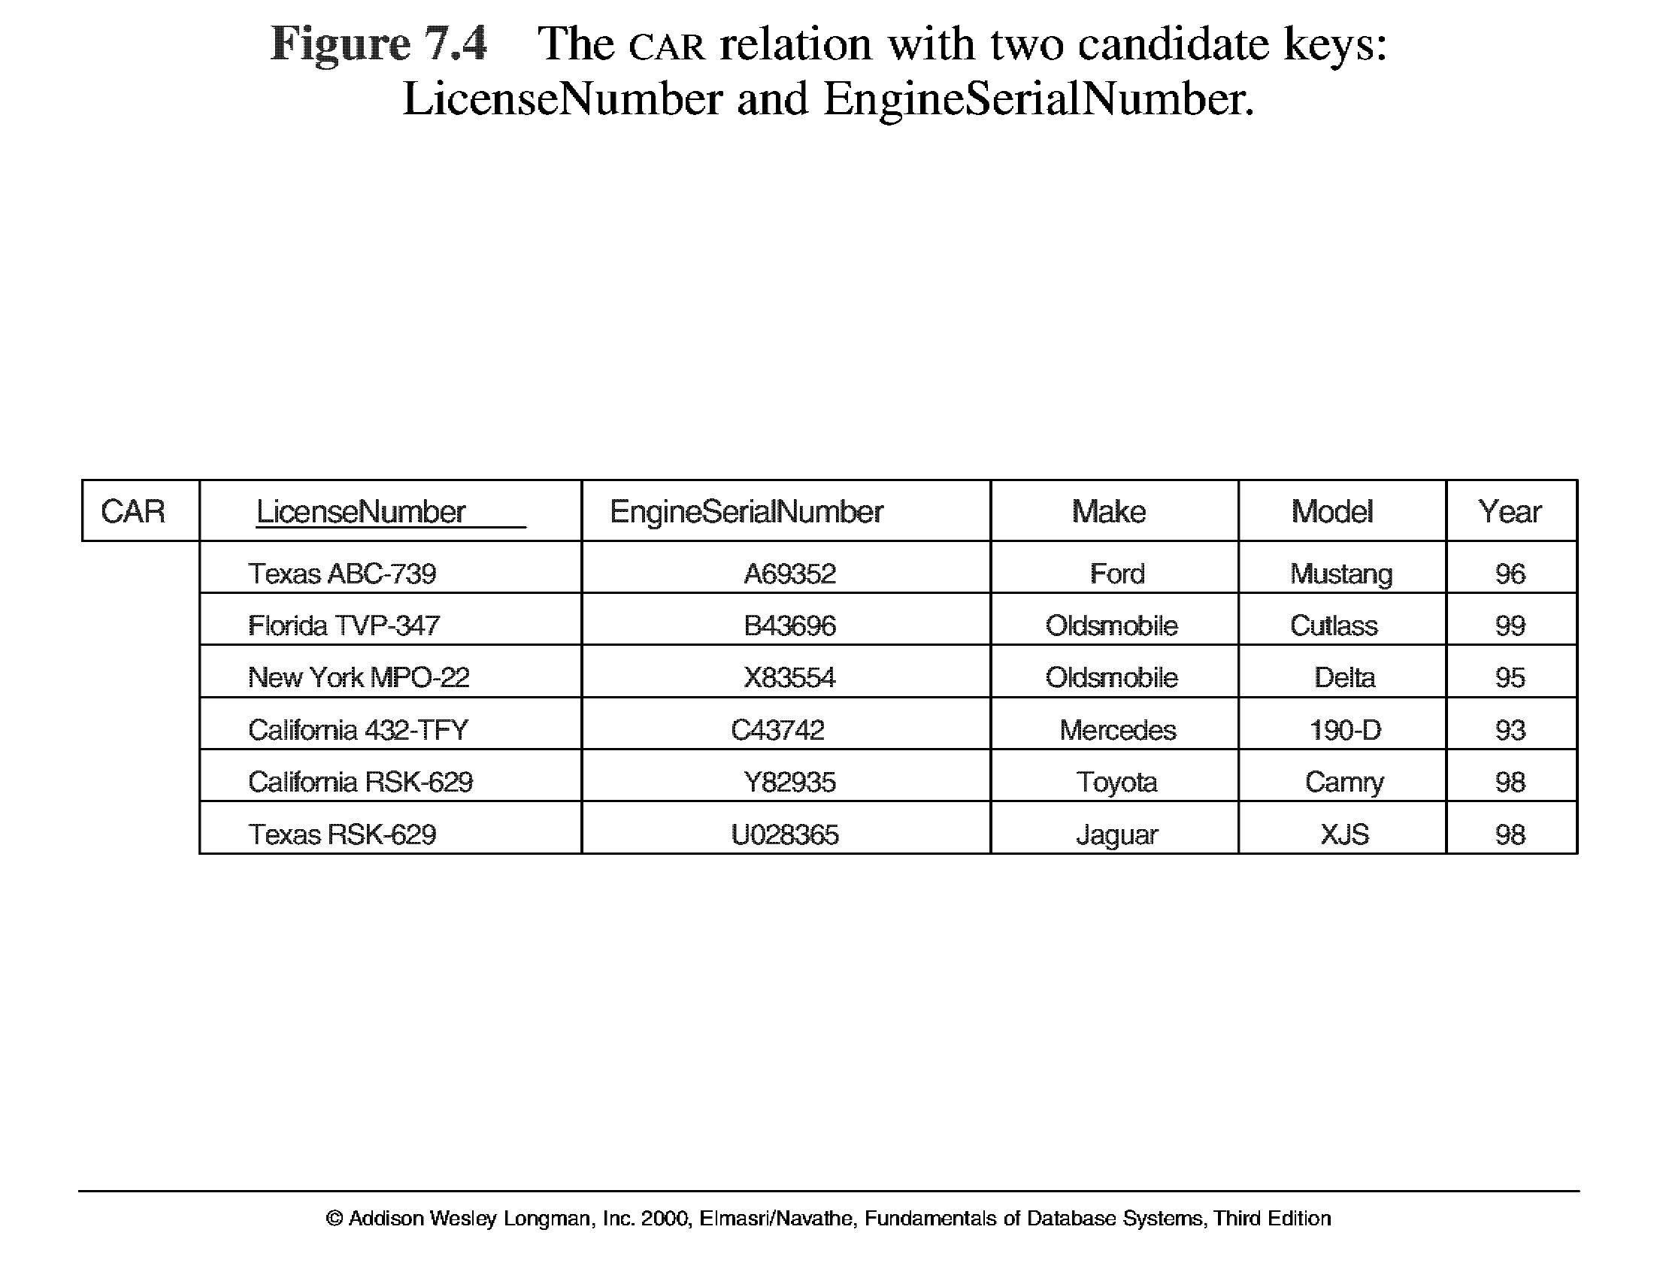
Key Constraints

Slide 8
Find super, candidate and primary keys
Software Versions
Year | Month | Date | Version
2016 | January | 15 | I
2016 | March | 15 | II
2015 | March | 30 | I
2014 | May | 1 | I
2013 | April | 1 | I
2013 | April | 15 | II

Slide 9
Constraints on Null values
Another constraint on attributes specifies whether NULL values are or are not permitted.
For example, if every STUDENT tuple must have a valid, non-NULL value for the Name attribute, then Name of STUDENT is constrained to be NOT NULL.

Slide 10
Entity Integrity
Relational Database Schema: A set S of relation schemas that belong to the same database. S is the name of the database.
S = {R₁, R₂, ..., R_{n}}
Entity Integrity: The primary key attributes PK of each relation schema R in S cannot have null values in any tuple of r(R). This is because primary key values are used to identify the individual tuples.
t[PK] ≠ null for any tuple t in r(R)
Note: Other attributes of R may be similarly constrained to disallow null values, even though they are not members of the primary key.

Slide 11
Referential Integrity
A constraint involving two relations (the previous constraints involve a single relation).
Used to specify a relationship among tuples in two relations: the referencing relation and the referenced relation.
Tuples in the referencing relation R₁ have attributes FK (called foreign key attributes) that reference the primary key attributes PK of the referenced relation R₂. A tuple t₁ in R₁ is said to reference a tuple t₂ in R₂ if t₁[FK] = t₂[PK].
A referential integrity constraint can be displayed in a relational database schema as a directed arc from R₁.FK to R₂.
A tuple in 1 rel that refers to another rel must refer to an existing tupl in that rel

Slide 12
Referential Integrity Constraint
Statement of the constraint
The value in the foreign key column (or columns) FK of the the referencing relation R₁ can be either:
(1) a value of an existing primary key value of the corresponding primary key PK in the referenced relation R_{2,}, or..
(2) a null.
In case (2), the FK in R₁ should not be a part of its own primary key.

Slide 13
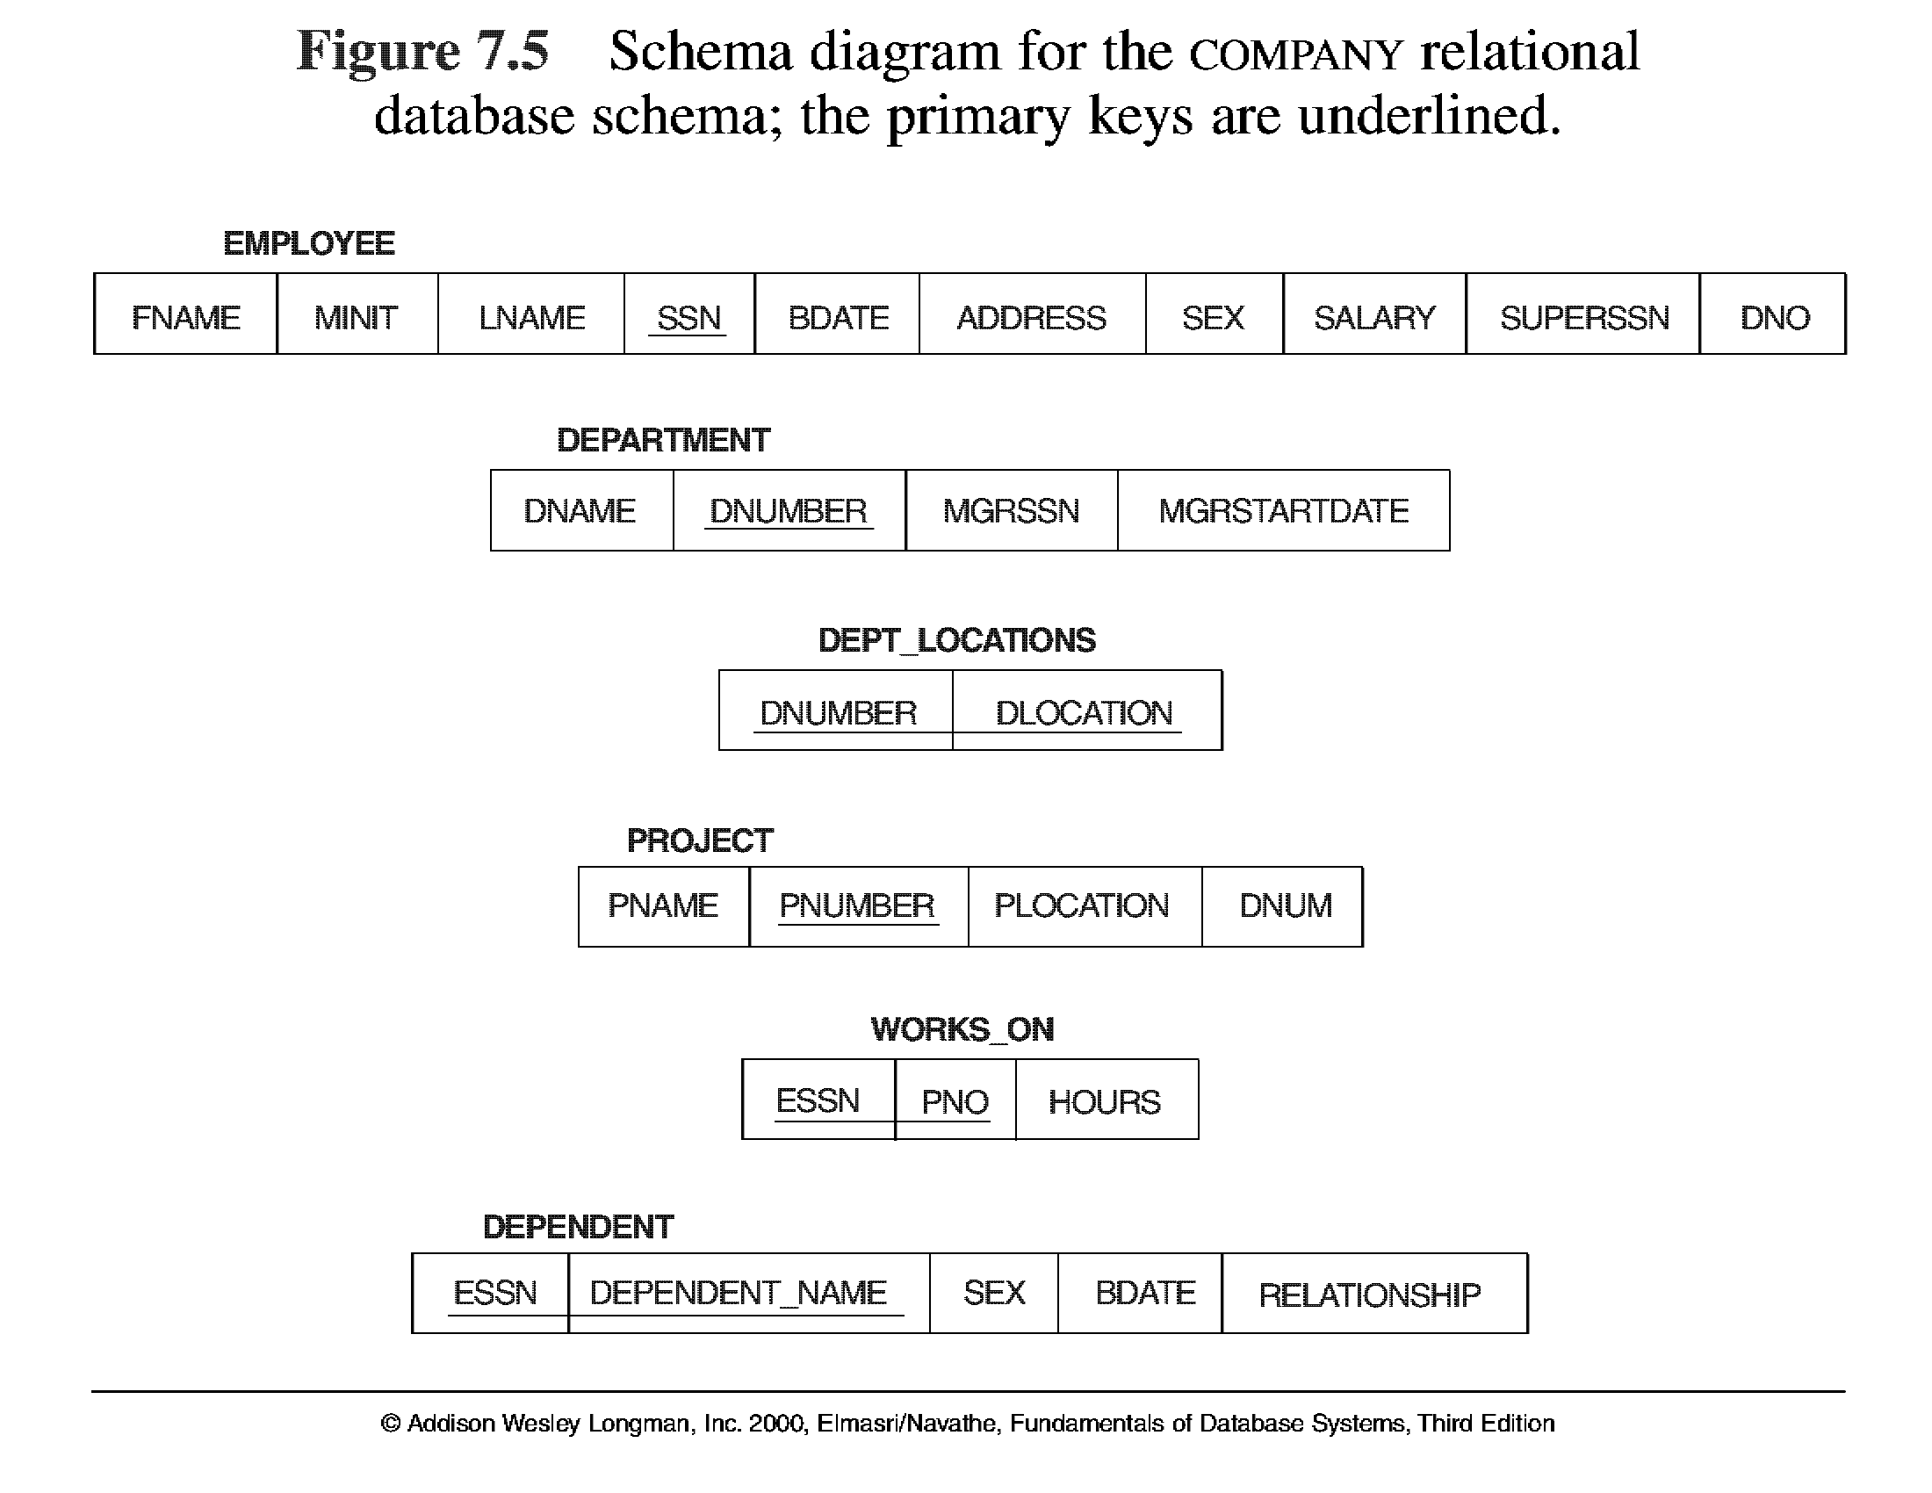

Slide 14
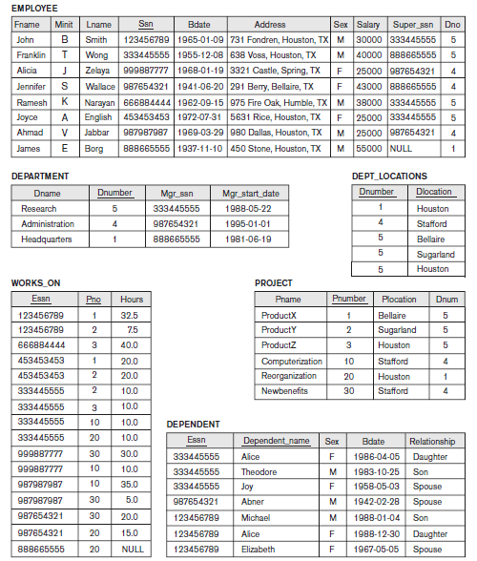

Slide 15
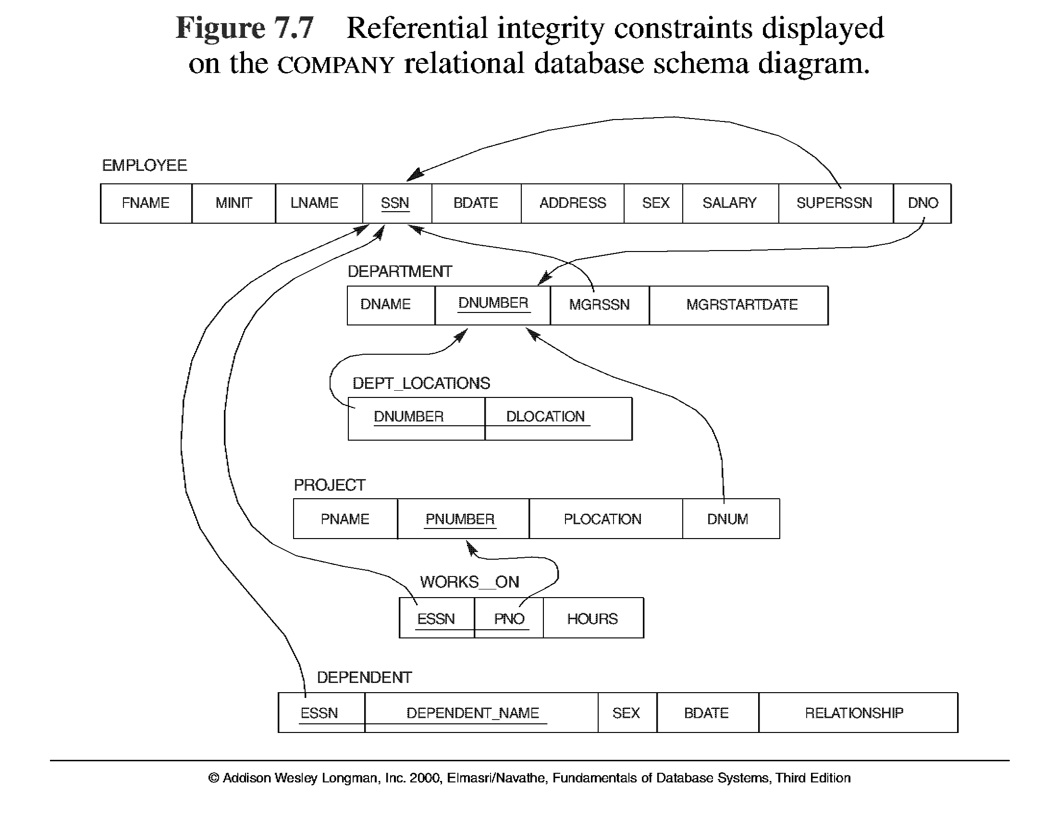

Slide 16
Other Types of Constraints
Semantic Integrity Constraints:
based on application semantics and cannot be expressed by the model
E.g., “the max. no. of hours per employee for all projects he or she works on is 56 hrs per week”
A constraint specification language may have to be used to express these
SQL-99 allows triggers and ASSERTIONS to allow for some of these

Slide 17
Update Operations on Relations
INSERT a tuple.
DELETE a tuple.
MODIFY a tuple.
Integrity constraints should not be violated by the update operations.
Several update operations may have to be grouped together.
Updates may propagate to cause other updates automatically. This may be necessary to maintain integrity constraints.

Slide 18
Few examples of insertion operation
Insert <‘Cecilia’, ‘F’, ‘Kolonsky’, NULL, ‘1960-04-05’, ‘6357 Windy Lane, Katy,TX’, F, 28000, NULL, 4> into EMPLOYEE.
Insert <‘Alicia’, ‘J’, ‘Zelaya’, ‘999887777’, ‘1960-04-05’, ‘6357 Windy Lane, Katy,TX’, F, 28000, ‘987654321’, 4> into EMPLOYEE.
Insert <‘Cecilia’, ‘F’, ‘Kolonsky’, ‘677678989’, ‘1960-04-05’, ‘6357 Windswept, Katy, TX’, F, 28000, ‘987654321’, 7> into EMPLOYEE.
Insert <‘Cecilia’, ‘F’, ‘Kolonsky’, ‘677678989’, ‘1960-04-05’, ‘6357 Windy Lane,Katy, TX’, F, 28000, NULL, 4> into EMPLOYEE.

Slide 19
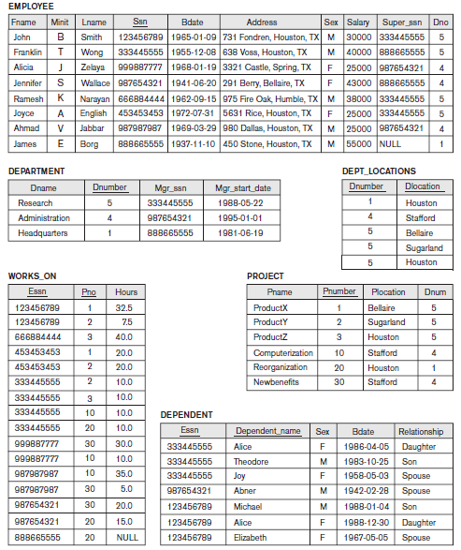

Slide 20
Few examples of deletion operation
Delete the WORKS_ON tuple with Essn = ‘999887777’ and Pno = 10.
Delete the EMPLOYEE tuple with Ssn = ‘999887777’.
Delete the EMPLOYEE tuple with Ssn = ‘333445555’.

Slide 21
Few examples of update operation
Update the salary of the EMPLOYEE tuple with Ssn = ‘999887777’ to 28000.
Update the Dno of the EMPLOYEE tuple with Ssn = ‘999887777’ to 1.
Update the Dno of the EMPLOYEE tuple with Ssn = ‘999887777’ to 7.
Update the Ssn of the EMPLOYEE tuple with Ssn = ‘999887777’ to ‘987654321’.

Slide 22
Update Operations on Relations
In case of integrity violation, several actions can be taken:
Cancel the operation that causes the violation (REJECT option)
Perform the operation but inform the user of the violation
Trigger additional updates so the violation is corrected (CASCADE option, SET NULL option)
Execute a user-specified error-correction routine

Slide 23
In-Class Exercise
(Taken from Exercise 5.15)
Consider the following relations for a database that keeps track of student enrollment in courses and the books adopted for each course:
STUDENT(SSN, Name, Major, Bdate)
COURSE(Course#, Cname, Dept)
ENROLL(SSN, Course#, Quarter, Grade)
BOOK_ADOPTION(Course#, Quarter, Book_ISBN)
TEXT(Book_ISBN, Book_Title, Publisher, Author)
Draw a relational schema diagram specifying the foreign keys for this schema.

